Slide 1

Driver drowsiness detection system
Q

Slide 2
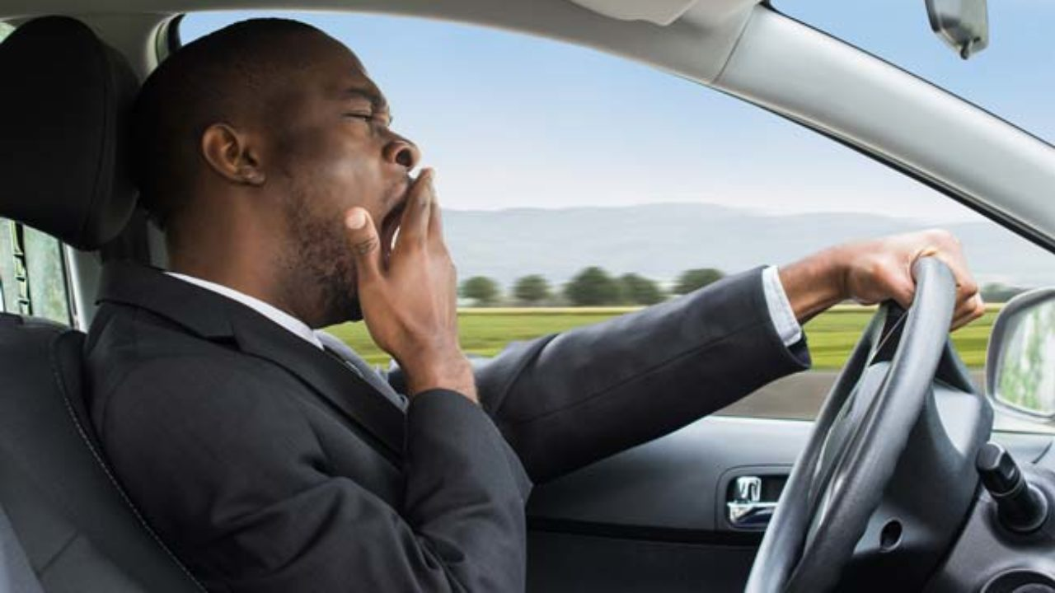
Introduction
A countless number of people drive on the highway day and night. Taxi drivers, bus drivers, truck drivers and people traveling long-distance suffer from lack of sleep. Due to which it becomes very dangerous to drive when feeling sleepy.
The majority of accidents happen due to the drowsiness of the driver. So, to prevent these accidents we will build a system using Python, OpenCV, and Keras which will alert the driver when he feels sleepy.

Slide 3
Abstract
One kind of carelessness is not admitting when we are too tired to drive. In order to monitor and prevent a destructive outcome from such negligence, many researchers have written research papers on driver drowsiness detection systems. But at times, some of the points and observations made by the system are not accurate enough.
Hence, to provide data and another perspective on the problem at hand, in order to improve their implementations and to further optimize the solution, this project we will make.
This project will describe on how to detect the eyes and mouth in a video recorded. In the video, a participant will drive the driving simulation system and a webcam will be place in front of the driving simulator. The video will be recorded using the webcam to see the transition from awake to fatigue and finally, drowsy. The designed system deals with detecting the face area of the image captured from the video.
From there, locating the eyes and mouth can be performed. Once the eyes are located, measuring the intensity changes in the eye area determine the eyes are open or closed.
If the eyes are found closed for 15 score, it is confirming that the driver is in drowsiness condition

Slide 4
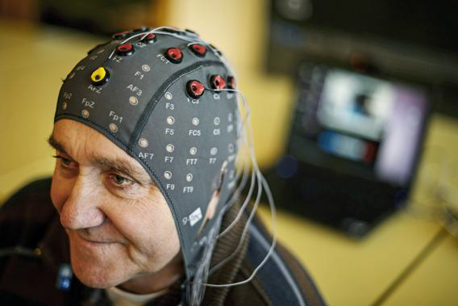
Literature Review
There are many previous researches regarding driver drowsiness detection system that can be used as a reference to develop a real-time system on detecting drowsiness for drivers. There is also several method which use different approaches to detect the drowsiness signs.
One of them is Electroencephalography (EEG) for Drowsiness Detection.
Electroencephalography (EEG) is a method that measures the brain electrical activity.
It can be used to measure the heartbeat, eye blink and even major physical movement such as head movement.
It uses a special hardware that place sensors around the top of the head area
to sense any electrical brain activity.

Slide 5
Problems with EEG system
It is very sensitive to noise around the sensors. For example, when the person is doing the EEG experiment, the surrounding area must be completely silent. The noise will interfere with the sensors that detect the brain activity.
Another disadvantage of this method is that even if the result might be accurate, it is not suitable to use for real driving application. Imagine when a person is driving and he is wearing something on his head with full of wires and when the driver moves their head, the wire may strip off from their place.
Also its expensive as more number of wires are used in this process.

Slide 6
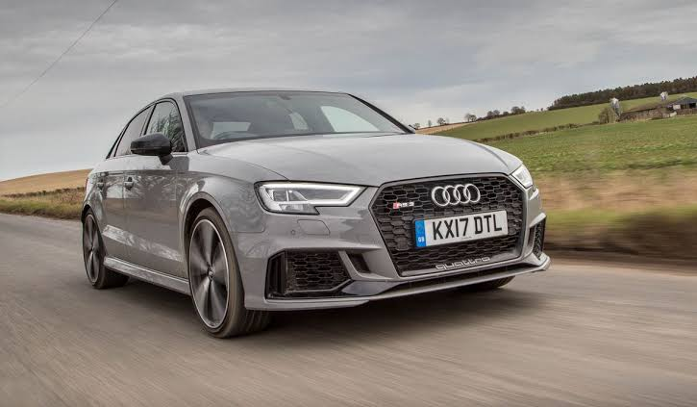
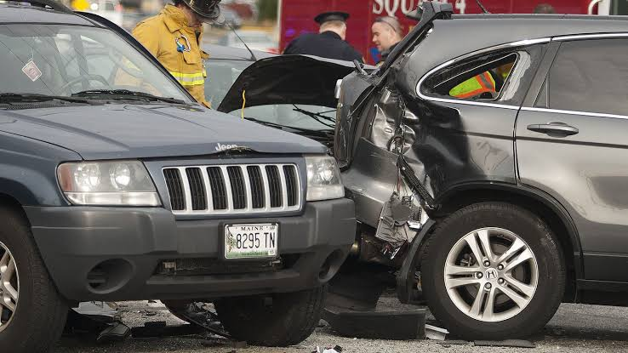
Objective
Nowadays the driver safety in the car is one of the most wanted system to avoid accidents.
Ensure safety system
For enhancing safety we are detecting the eye blinks of the driver and estimating the driver status and control the car accordingly.

Slide 7
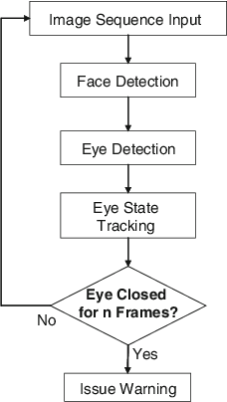
Project Architecture
In this Python project, we will be using OpenCV for gathering the images from webcam and feed them into a deep learning model(CNN) which will classify whether the person’s eyes are ‘Open’ or ‘Closed’. The approach we will be using for this Python project is as follows :
Step 1 – Take image as input from a camera.
Step 2 – Detect the face in the image and create a Region of Interest (ROI).
Step 3 – Detect the eyes from ROI and feed it to the classifier.
Step 4 – Classifier will categorize whether eyes are open or closed.
Step 5 – Calculate score to check whether the person is drowsy.

Slide 8
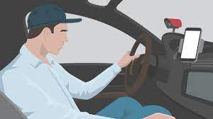
Step 1 – Take image as input from a camera.

Slide 9
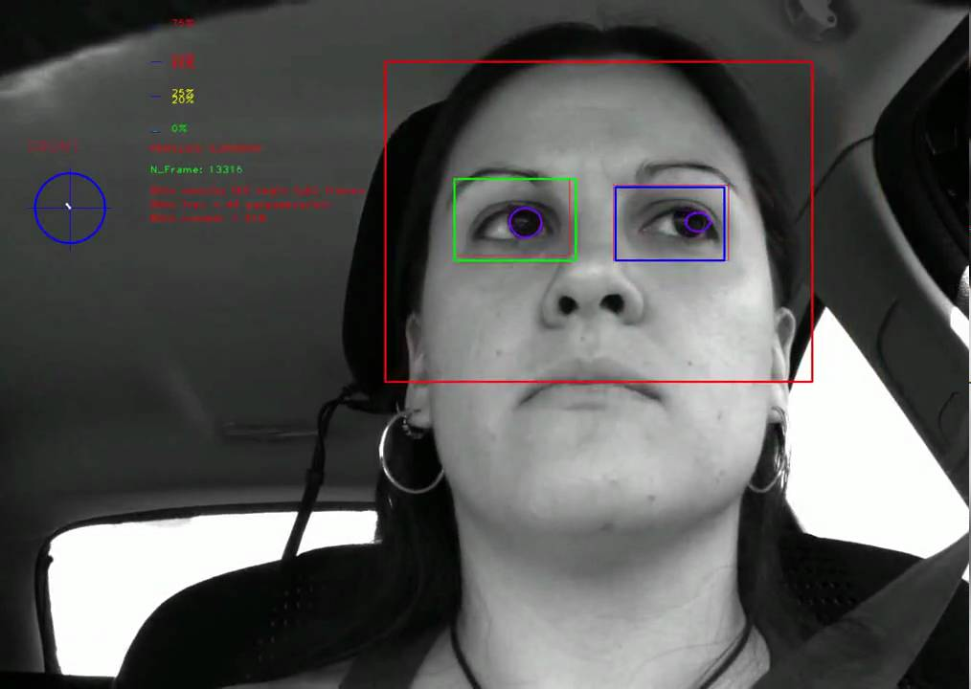
Step 2 – Detect the face in the image and create a Region of Interest (ROI).

Slide 10
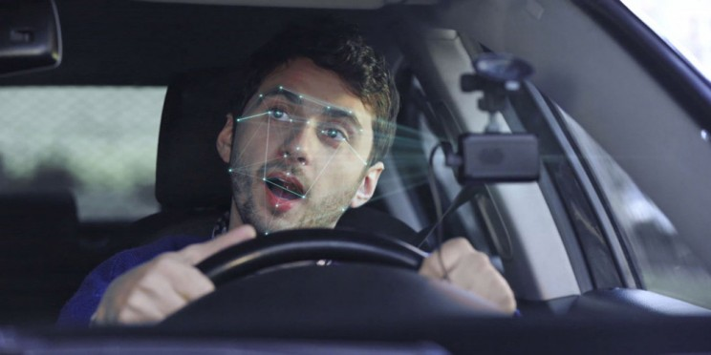
Step 3 – Detect the eyes from ROI and feed it to the classifier.

Slide 11
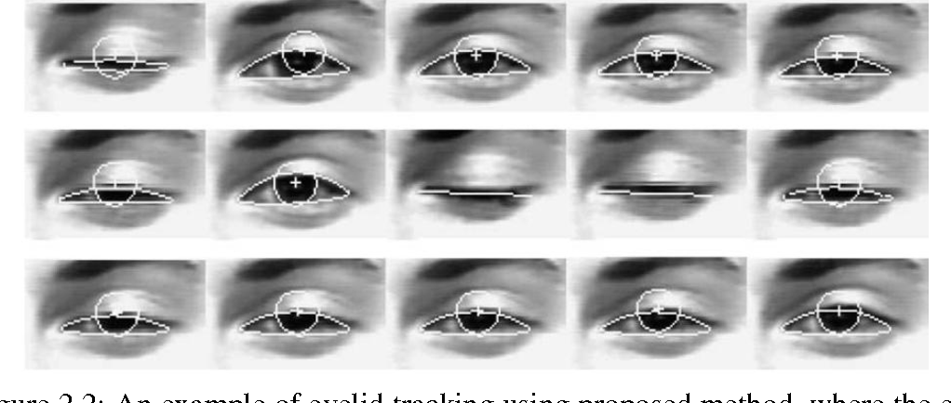
Step 4 – Classifier will categorize whether eyes are open or closed.

Slide 12
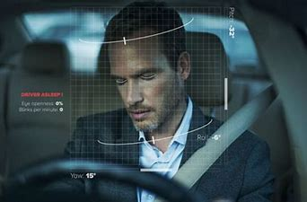
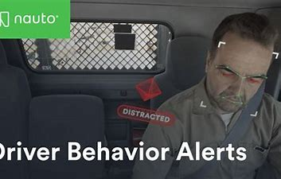
Step 5 – Calculate score to check whether the person is drowsy.
1
2
3

Slide 13
How this works
Detect the face
Categorize whether eyes are open or not
Calculate score whether person is drowsy

Slide 14
Methodology
Start
Background study
Literature review
Gathering data and parameters involved
Algorithm design & development
Analysis & Testing
Data Collection through experiment
Finish

Slide 15
Advantages
Disadvantages
It does not get affected by noise.
It is simple and wire free system so it does not hamper driving.
It is user friendly and real time application
Feasible for any kind of driving (airways, roadways etc.)
Application
Real time tracking application.
Classification of small particles.
The size area of eye might vary from one person to another. Someone may have small eyes and looks like it is sleepy but some are not.
If the person is wearing glasses, there is obstacle to detect eye region.
The images that being captured must be in certain range from the camera because when the distance is far from the camera, the images are blurred

Slide 16
thankyou
Have a nice day ahead.

